Slide 1
WildSight: Real-Time Wildlife Encyclopedia
Name: Abhinav Kumar Saxena(2022018), Akanksh Semar(2022046), Akshat Gian(2022051), Kunal(2022260)
Advisor: Dr. Saket Anand
Date: 23rd April ‘25
Course: Computer Vision

Slide 2
Problem Statement, Scope & Users
Problem Statement: Identifying wildlife animals, birds and insects in dynamic environments like safaris, zoos, and nature reserves is challenging for the general public without expert knowledge.
Limitations in Current Solutions:
Lack real-time processing.
Are inaccessible in remote areas.
Do not provide intuitive and instant species classification.
Data Privacy and Security Issues
Proposed Solution: Develop a real-time animal recognition system using computer vision on edge devices to improve wildlife education, conservation, and awareness.
Target Users:
Wildlife Enthusiasts & Tourists: Identify animals during safaris or nature walks.
Wildlife Park Authorities: Monitor animals in real time and ensure visitor engagement.
Ecologists & Conservationists: Enable real-time data collection for research and monitoring.
Filmmakers & Documentarians: Assist with accurate species identification during filming.
Tour Guides & Travel Agencies: Enhance guided tours by providing real-time wildlife insights.
Educators & Students: Facilitate interactive learning experiences for wildlife education.

Slide 3
Related work and baseline methods.
We’ve read multiple papers and articles. From that we found multiple different models which work really well but they are environment-specific. We wish to create an application that works for multiple environments.
Model | Strengths | Limitations
Megadetector (Detection) | Efficiently detects animals, humans, and vehicles in diverse environments | Lacks species-level classification and struggles in low-light conditions.
SpeciesNet (Classification) | Accurately classifies animal species from cropped images | Limited by its reliance on prior object detection and may misclassify visually similar species
YOLO (General) | Fast, real-time detection | Struggles in low-light, occlusions
YOLOv8-Night | Optimized for night vision, IR processing | Requires specialized infrared data
Real-Time Wildlife Detection Using MobileNet-SSD V2 (UAVs & Thermal Imaging) | Lightweight, drone-friendly | Less accurate than heavier models
WildDect-YOLO | Optimized for dense forests, fewer false positives | May not generalize to open landscapes

Slide 4
Dataset and Evaluation Metrics
Dataset
iWildCam 2020 (Source) – This dataset comprises over 280,000 camera trap images collected from 552 locations worldwide. It presents a challenging real-world scenario by providing training and testing data from different camera locations, thereby promoting the development of models that generalize well to new, unseen environments.
iNaturalist 2017 (Source) – Featuring approximately 675,000 images spanning over 5,000 species, this dataset offers a rich collection of photographs contributed by citizen scientists. The images capture species in diverse settings, with varying image quality and class distributions, reflecting real-world complexities in species identification.
Annotation Process: We have transitioned to utilizing MegaDetector, an AI-based object detection model, to automate the annotation process for our dataset. The annotations generated by MegaDetector are converted into the YOLOv8 format, which requires each image to have a corresponding text file. Each line in the text file represents an object annotation in the format: class_id center_x center_y width height, with coordinates normalized between 0 and 1.
Evaluation Metrics
Intersection over Union (IoU): IoU measures the overlap between the predicted and ground truth bounding boxes, calculated as: IoU = Area of Overlap / Area of Union, A higher IoU indicates better model accuracy. Setting a strict IoU threshold ( eg. 0.5 or 0.75) ensures rigorous evaluation, making the model more reliable for real-world use.
Mean Average Precision (mAP): mAP is a key metric for object detection, averaging precision across recall levels at various IoU thresholds. It is computed as: AP = Σₙ (Rₙ - Rₙ₋₁) Pₙ, where Rₙ and Pₙ are recall and precision at different confidence levels.
We evaluate mAP@0.5 (IoU ≥ 0.5) and mAP@0.5:0.95 (averaged over IoU 0.5–0.95) for a comprehensive measure of precision-recall trade-offs across object categories.

Slide 5
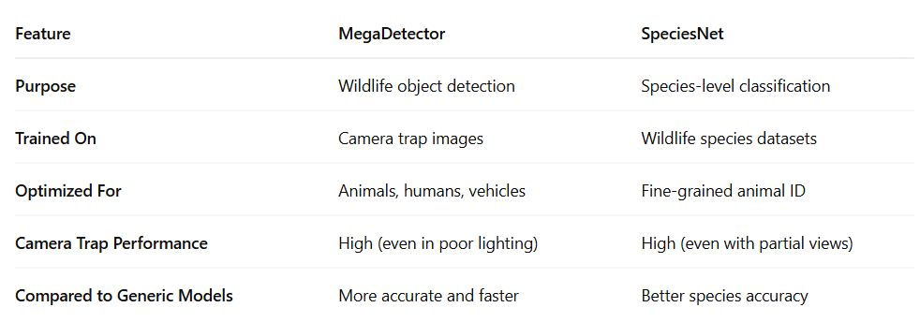
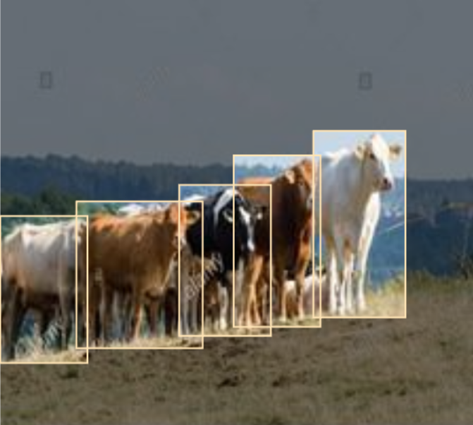
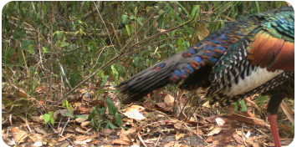
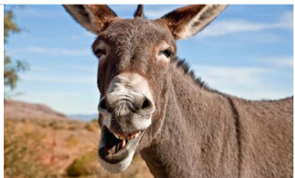
System, Baseline Results and their Analyses
MegaDetector for detection and SpeciesNet for Classification:
Leveraging efficiency and robustness of Megadetector, followed by accurate species classification via SpeciesNet
Dataset Selection:
Earlier, we had accumulated different images and were annotating on our own.
After feedback, we’ve selected iWildCam2020 and iNaturalist 2017.
iWildCam 2020
iNatruralist 2017
Earlier
Present

Slide 6
System, Baseline Results and their Analyses
Object Detection Performance(MegaDetector):
Species Classification Performance(SpeciesNet)
Metric | Reported Value | Context
Precision (Animal) | 0.98 | At 0.65 confidence threshold on camera trap data (ai-camtraps.netlify.app)
Recall (Animal) | 0.93 | Same as above (ai-camtraps.netlify.app)
F1 Score (Animal) | 0.96 | Same as above (ai-camtraps.netlify.app)
Overall Accuracy | 0.93 | Same as above (ai-camtraps.netlify.app)
Precision (Animal) | 0.82 | At 0.90 confidence threshold in recreation ecology study (sciencedirect.com)
Recall (Animal) | 0.92 | Same as above (sciencedirect.com)
Accuracy (Animal) | 0.96 | Across 352,426 images from 3 regions (zslpublications.onlinelibrary.wiley.com)
Metric | Reported Value | Context
Top-1 Accuracy | 0.918 | On test set of 5,080 images across 19 species (pmc.ncbi.nlm.nih.gov)
Top-5 Accuracy | 0.971 | For predictions with confidence > 0.90 (pmc.ncbi.nlm.nih.gov)
Average Precision (AP) | 0.962 | Across species, range: 0.928–0.994 (pmc.ncbi.nlm.nih.gov)
Recall | 0.945 | Across species, range: 0.888–0.998 (pmc.ncbi.nlm.nih.gov)
Mean AP [50–95] | 0.913 | Range: 0.869–0.972 (pmc.ncbi.nlm.nih.gov)

Slide 7
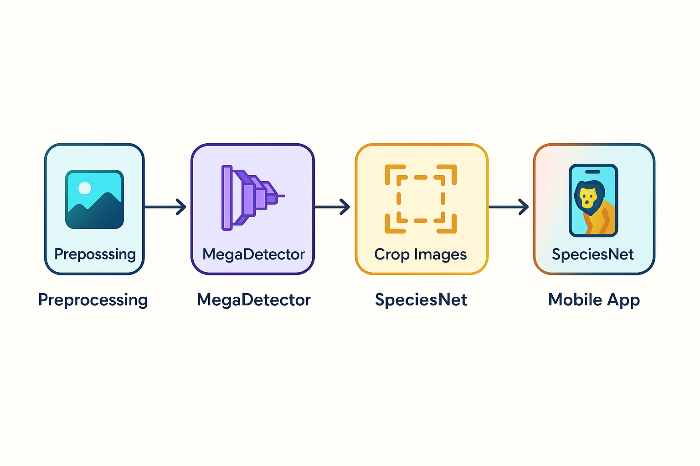
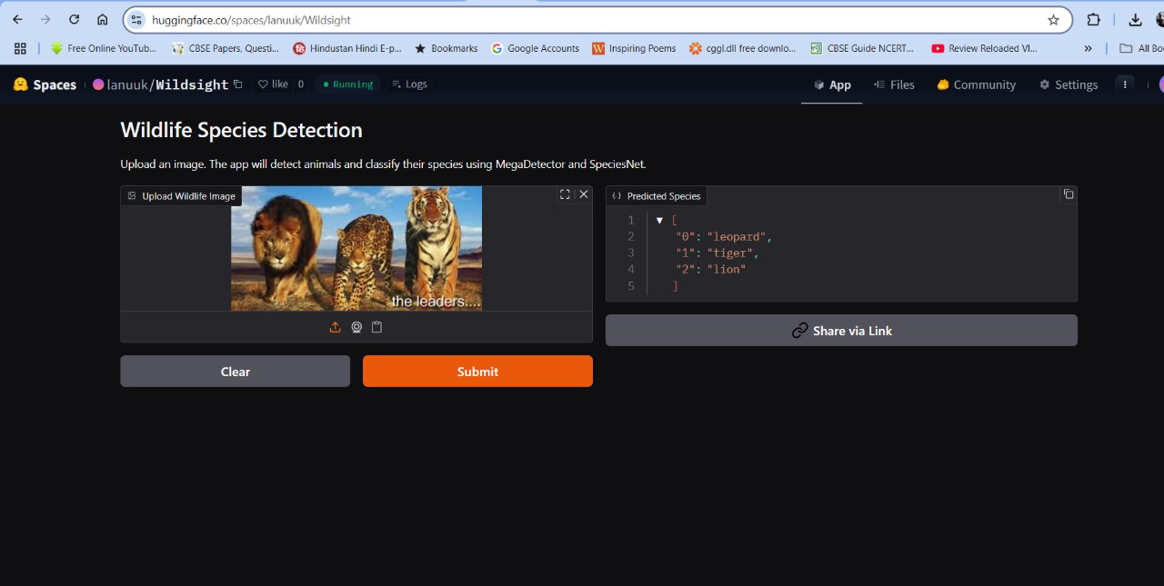
Additional Results (Post-Interim)
Pipeline Development: We successfully developed a comprehensive pipeline that seamlessly integrates MegaDetector for animal detection and bounding box generation, followed by SpeciesNet for classifying the cropped images.
Model Integration: MegaDetector was used to detect animals and generate bounding boxes, which were cropped and passed to SpeciesNet for accurate species classification, with the results and confidence scores displayed in the app.
App Development: We developed a Flutter app with an intuitive interface to display real-time species identification results from the pipeline, along with related information from the database.
Deployment and Testing: The integrated pipeline and Flutter app were successfully deployed and tested with real-time images, demonstrating low-latency performance on edge devices and confirming their readiness for effective wildlife monitoring in conservation settings.
Comprehensive Literature Review: Conducted an in-depth review of existing research and methodologies relevant to our project domain.
Fig. Pipeline Diagram
Fig. Testing Working Model on HuggingFace

Slide 8
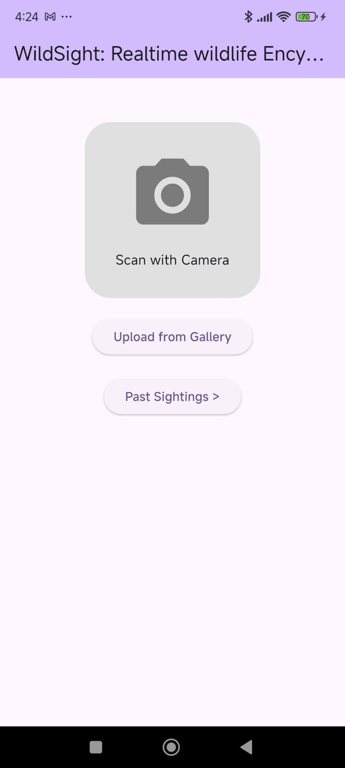
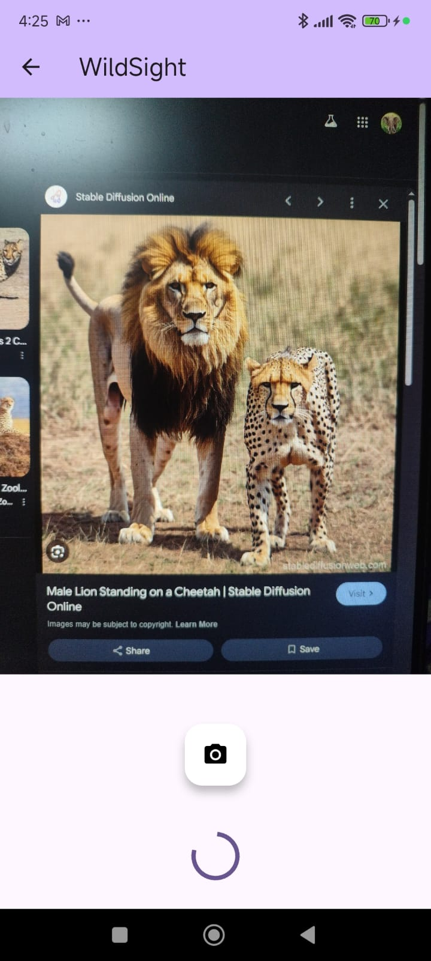
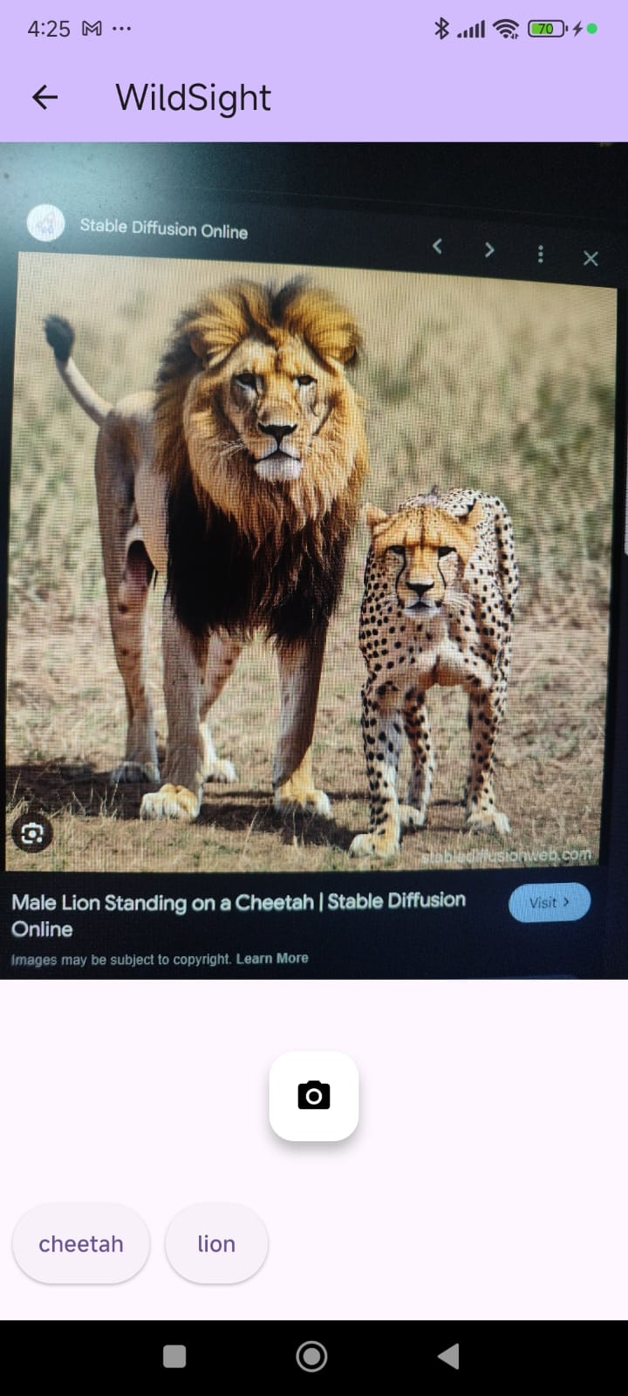
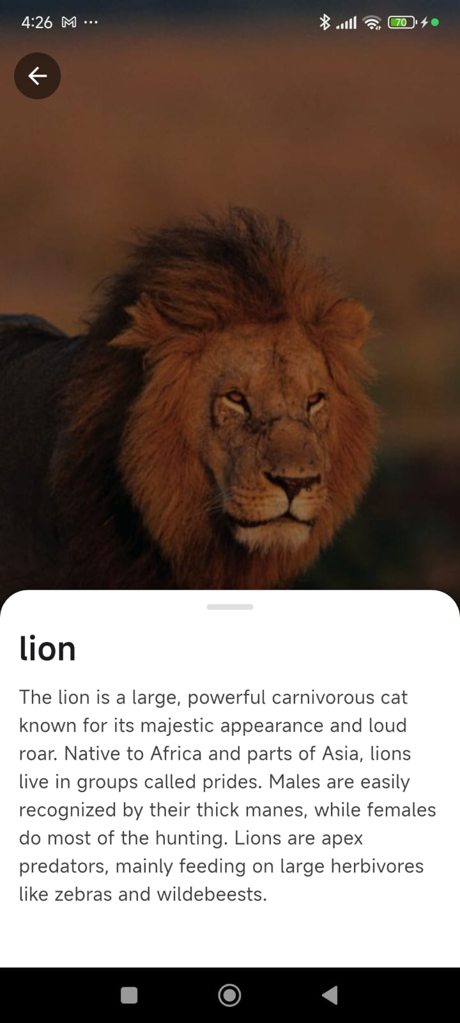
Demonstration
Fig 1. Landing Page/Home Page
Fig 2. Uploading an Image
(Processing Stage)
Fig 3. Displaying the Results from HugginFace
Fig 4. Displaying the Animal Info from Database

Slide 9
Individual Contributions
Pre-Midsem Work Distribution:
Dataset Creation: Abhinav, Akshat and Akanksh
Dataset Annotation: Abhinav and Akanksh
Model Training: Akshat and Kunal
Literature Review: Abhinav, Akshat, Akanksh, Kunal
Post-Midsem Work Distribution:
Data Collection and Preprocessing: Abhinav, Akshat and Akanksh
Model Selection and Integration: Abhinav and Akanksh
Pipeline Development: Akshat and Kunal
App Development (Flutter): Abhinav, Akshat, Akanksh and Kunal
Literature Review: Akanksh, Kunal

Slide 10
Thank You

